Slide 1


Touch-Point Meetings
Notes:
This definition origins from Sales – when you need to get in touch with your customer.
Being a PM / supervisor / mentor, your colleague / employee / subordinate is your customer.
It consumes values, goals …… that obtains from you.

Slide 2
Pathway
WHY
HOW
NEXT
CASE
WHAT

Slide 3
communication
Feedback
Interpret
Message
Encode
Decode
One to One
One to Few
One to Many
Notes:
Effective communication:
Flow
Levels

Slide 4


What
Which of you have 121 meetings?
121
One-to-One
Face-to-Face
Notes:
The supervisor-employee relationship is the fundamental organizational unit within the County structure. All teams are built on those. One-to-one meetings are a forum for communication from supervisor to employee, as well as from employee to supervisor.

Slide 5
Pathway
WHY
HOW
NEXT
CASE
WHAT

Slide 6

WHY
70%
Leads don’t arrange 121s
30%
Not all have 121s on regular basis
Notes:
When employees are informed the feeling of involvement increases, along with the sense of ownership that results in job satisfaction and productivity. The employee's role is to take responsibility for what they need from you as their supervisor. Your responsibility is to provide support and add value that helps the employee perform well.

Slide 7

WHY
Morale
Stress
Obstacles
Issues
Value-added Feeback
Involvement
Relationship
Performance
Ownership
Coaching
Provide support
Discuss specific issues
Share formal and informal information about the unit and organization
Notes:
When employees are informed the feeling of involvement increases, along with the sense of ownership that results in job satisfaction and productivity. The employee's role is to take responsibility for what they need from you as their supervisor. Your responsibility is to provide support and add value that helps the employee perform well.
Find out about the employee’s current level of morale, stress, etc.
Track the status of Performance and Development Goals
Learn if there are obstacles to goal achievement that need to be removed
Discuss specific issues
Provide value-added feedback
Provide coaching
Share formal and informal information about the unit and organization

Slide 8
Pathway
WHY
HOW
NEXT
CASE
WHAT

Slide 9




HOW
REGULARITY
Length: 15-30 min
Recurrence: Weekly / biWeekly
ATTENTION
All the time and focus to just one person
OBLIGATION
Create action items
Track and check accomplishment
FOCUS
Resolve problem – not person
Notes:
Topics TBD
Length
Format
*Open-ended questions !!!

Slide 10


HOW
Control mood: positive, open and friendly
Start with explanation of need again
Send out RECURRING appointments with LINK
Allocate room / place WITHOUT DISTURBANCE
Generate personal spaces per person
Create page template WISELY
Inform Team 121s are about to be launched
Do you think there are steps missing?
Notes:
Add agenda
HOW TO PREPARE !!!

Slide 11


HOW
Free-form meeting, NOT a Status Report
Manager does 90% listening / 10 % talking
Use open-ended question
Feedback: Positive + Value-added
Issues has to be resolved
Notes:
Add agenda
HOW TO PREPARE !!!

Slide 12
Pathway
WHY
HOW
NEXT
CASE
WHAT

Slide 13

Next
Evolving with Agenda
None
Just a list
Action Items
Status Tracking
Any ideas of what else can be added?
Notes:
Add agenda
HOW TO PREPARE !!!

Slide 14
Pathway
WHY
HOW
NEXT
CASE
WHAT

Slide 15
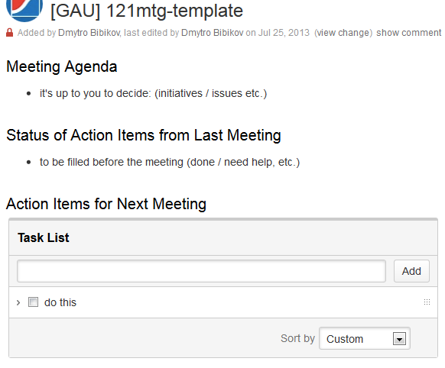
Case
Notes:
Add snapshots from 121 confluence pages
Add Sample of tracking tool

Slide 16
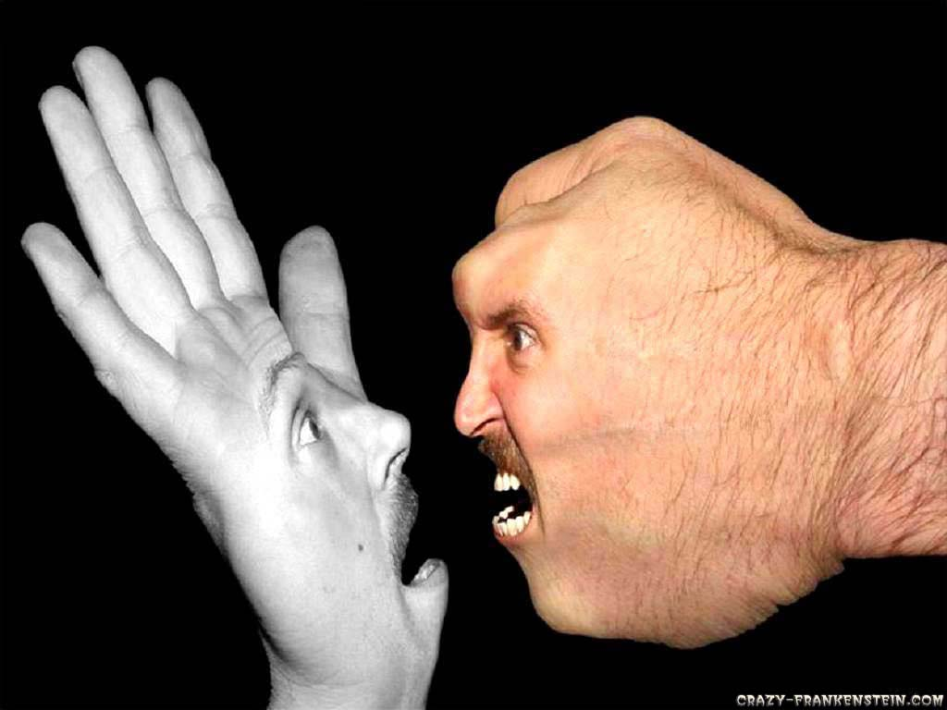
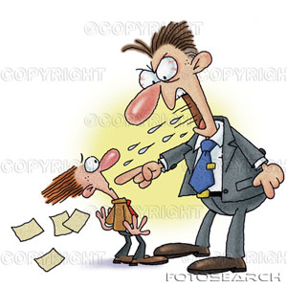

Case
This is NOT 121 !!!
Notes:
Add snapshots from 121 confluence pages
Add Sample of tracking tool

Slide 17


Choice for prosperity

Slide 18
Referrences
http://www.michaelnichols.org/one-on-one-meeting/
http://allthingsd.com/20120829/one-on-one/
http://www.task.fm/How-can-you-have-successful-one-on-one-meetings-with-your-employees
http://agile.dzone.com/articles/one-one-meetings
http://www.edqm.eu/en/certification-technical-advice-160.html
http://www.kebuki.com/2012/05/dont-run-another-meeting-without-this.html
http://www.sans.edu/research/management-laboratory/article/oneonone-meetings
http://www.co.sanmateo.ca.us/portal/site/HR/menuitem.cad47643f6ef262515598b81917332a0/?vgnextoid=f8e659498aaff210VgnVCM1000001937230aRCRD&vgnextchannel=170a046eb8170310VgnVCM1000001937230aRCRD&vgnextfmt=subDivisionsDetails

